Slide 1
STUDENT ALCOHOL CONSUMPTION ANALYSIS
PRESENTED BY :
Nisha Deepak Ingle

Slide 2
Problem Statement
Academic success is a crucial aspect of a student's educational journey, encompassing their performance in exams and overall learning outcomes.
Various factors can significantly influence a student's ability to excel in their studies and one of them is alcohol consumption.
Across the globe, heavy alcohol consumption among the students have been observed.
Alcohol consumption has not just affected the student’s health but as well their grades.

Slide 3
Objective:
The data were obtained in a survey of students math and portugal courses in secondary school. It contains a lot of interesting social, gender and study information about students.
The objective here is to explore and analyze the data and provide some data visualizations that can aid in understanding the data.

Slide 4
Data Description to understand the variables
school - student's school (binary: 'GP' - Gabriel Pereira or 'MS' - Mousinho da Silveira)
sex - student's sex (binary: 'F' - female or 'M' - male)
age - student's age (numeric: from 15 to 22)
address - student's home address type (binary: 'U' - urban or 'R' - rural)
famsize - family size (binary: 'LE3' - less or equal to 3 or 'GT3' - greater than 3)
Pstatus - parent's cohabitation status (binary: 'T' - living together or 'A' - apart)
Medu - mother's education :
0 - none,
1 - primary education (4th grade)
2 – 5th to 9th grade, 3 – secondary
4 – higher education)

Slide 5
Fedu - father's education
0 - none,
1 - primary education (4th grade),
2 – 5th to 9th grade, 3 – secondary education
4 – higher education
Mjob - mother's job
'teacher',
'health' care related,
civil 'services' (e.g. administrative or police),
'at_home' or 'other')
Fjob - father's job
'teacher',
'health' care related,
civil 'services' (e.g. administrative or police),
'at_home' or 'other')

Slide 6
reason - reason to choose this school
close to 'home',
school 'reputation',
'course' preference or 'other'
guardian - student's guardian
'mother', 'father' or 'other'
traveltime - home to school travel time ( 1 - 1 hour)
studytime - weekly study time ( 1 - 10 hours)
failures- number of past class failures (numeric: n if 1<=n<3, else 4)
schoolsup - extra educational support ( yes or no)
famsup - family educational support ( yes or no)
paid - extra paid classes within the course subject (Math or Portuguese) (binary: yes or no)
activities - extra-curricular activities (yes or no)
nursery - attended nursery school ( yes or no)
higher - wants to take higher education ( yes or no)
internet - Internet access at home ( yes or no)

Slide 7
romantic - with a romantic relationship ( yes or no)
famrel - quality of family relationships ( from 1 - very bad to 5 - excellent)
freetime - free time after school ( from 1 - very low to 5 - very high)
goout - going out with friends ( from 1 - very low to 5 - very high)
Dalc - workday alcohol consumption ( from 1 - very low to 5 - very high)
Walc - weekend alcohol consumption ( from 1 - very low to 5 - very high)
health - current health status ( from 1 - very bad to 5 - very good)
absences - number of school absences ( from 0 to 93) #### These grades are related with the course subject, Math or Portuguese:
G1 - first period grade (numeric: from 0 to 20)
G2 - second period grade (numeric: from 0 to 20)
G3 - final grade (numeric: from 0 to 20, output target)

Slide 8
Steps for Model Building
Define the data
Importing libraries
EDA (Exploratory Data Analysis)
Feature Engineering
Train-Test splitting
Model building on training Data
Model Evaluation

Slide 9
EDA (Exploratory Data Analysis)
EDA includes:
Understanding the variables.
Cleaning Data
Visualization of Data
Analyzing Relationship between Data

Slide 10
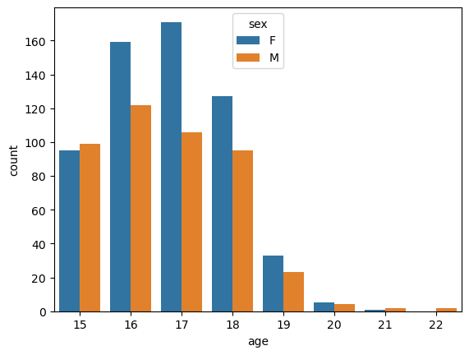
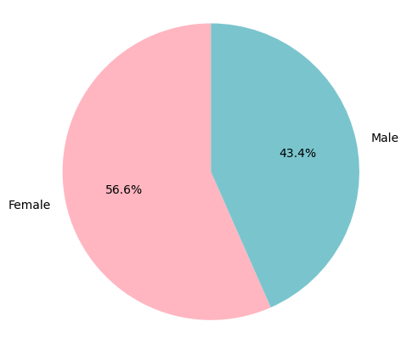
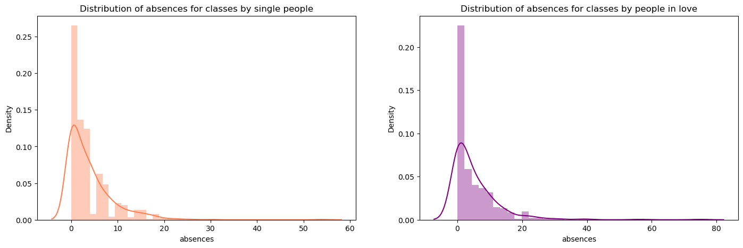

Slide 11
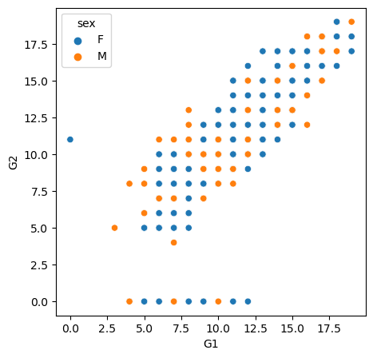
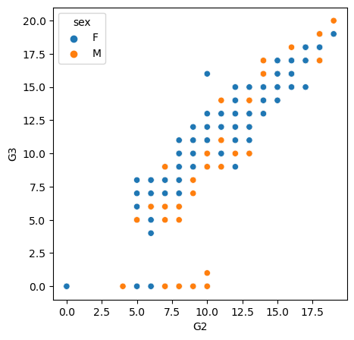
The grades have distributions similar to the normal distribution. There is a strong linear correlation between grade in the first period, grade in the second period, and final grade.

Slide 12
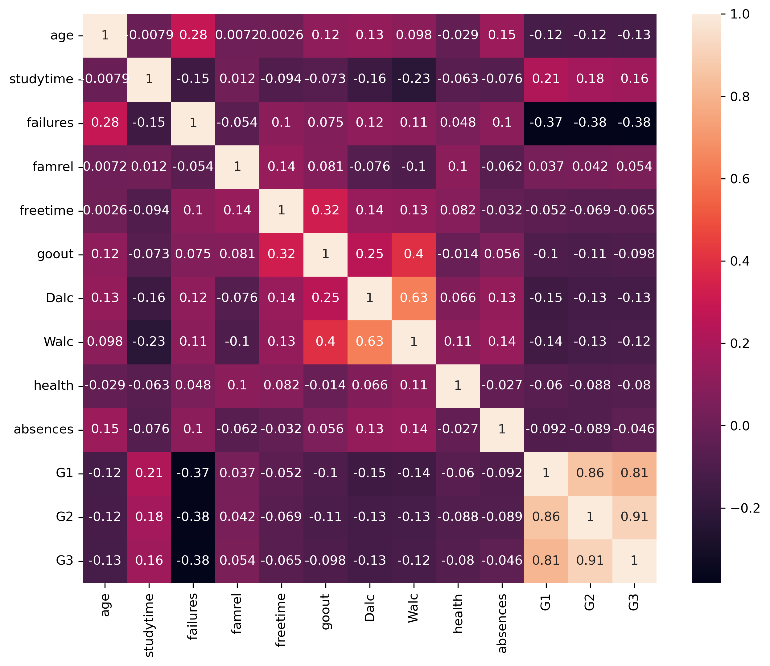
Correlation

Slide 13
Feature Engineering
Feature Engineering done in the project includes:
Encoding to convert categorical to numeric.
Feature Selection
Feature Scaling

Slide 14
Model Building
Defining x and y
Splitting the data
Training and testing the data
Trained the algorithm on training data
Prediction is done on testing data

Slide 15
Model Evaluation
Since our problem is regression problem, here performance metrics are :
Mean Absolute Error
Mean Squared Error
R2 Score

Slide 16
Conclusion As we can see, the Random Forest, Decision Tree and SVM models are the best for the model.
Algorithm and their accuracy score
Accuracy scores for each of the models when running on the train/test data split are as followed:
Linear Regression = 80.0%
Random Forest = 81.0%
Decision Tree = 81.0%
XGBoost = 80.0%
KNN = 77.0%
SVM = 81.0%

Slide 17
THANK YOU

